Slide 1



Presentation and demo exchanging invoice status information
Amsterdam, 29 January 2016

Slide 2
Agenda
1
Introduction round
2
Project history and update
3
Benefits of exchanging invoice status
4
Demonstration of the Proof of Concept
5
Lessons learned and next steps

Slide 3
Agenda
1
Introduction round
2
Project history and update
3
Benefits of exchanging invoice status
4
Demonstration of the concept
5
Lessons learned and next steps

Slide 5
Introductions and expectations

Slide 6
Agenda
1
Introduction round
2
Project history and update
3
Benefits of exchanging invoice status
4
Demonstration of the concept
5
Lessons learned and next steps

Slide 7



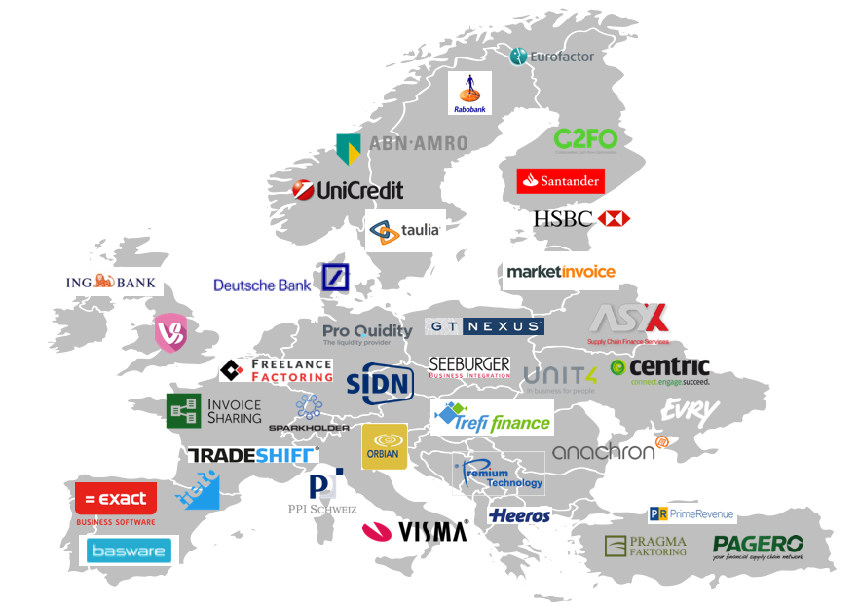
Project history: iterative approach turned out to be essential
2012-2013
ITERATION #0: 2014 SEP-DEC
ITERATION #1: 2015 OCT-JAN
Concept of standardising
invoice statuses across existing
invoice solutions crystalising
Research: does standardization of invoice status info and its exchange improve financeability of receivables?
Concept model used: Status Based Receivables Finance
Key outcomes:
Benefits are recognised
Buyers invoice approval is key
Buyers risk assessment could be enriched
Governance for trust is needed
Invoice status flows evolves from ‘self-declared’ to ‘guaranteed’
Recommendation
Scope the minimum viable product and create European coalition of the willing for standardizing invoice status exchange
“Demo” (proof) of concept and Coalition creation
Key outcomes:
European coalition not feasible yet, different levels of engagement
Start open and small
Successful Proof of Concept NL
Recommendation
Create PoC in other communities
Extend NL PoC
Build scope based on experiences

Slide 8








Project overview
Iteration #1
Today
Iteration #2
Further iterations >>
Project plan
Workshop
17 Nov
Webinar
10 Dec
Workshop
15 Jan
Harmonization of specs
Harmonization of specs
Track 1:
Standardisation
Project plan
Harmonization of specs
Knowledge sharing
PoC reports
PoC report
New PoC A
New PoC B
Working PoCs
Track 2:
Proof of Concept
PoC presentation
Specification & design PoC
Working PoC platform
PoC presentations
PoC live
New PoC C
PoC NL Sprint 1
PoC NL Sprint 2
PoC NL Sprint 3
Extend NL PoC
Track 3:
Project-mgmt
Iteration review
Iteration review
Meetings & regular touch points
Nov 2015
Dec 2015
Jan 2016
Mar – Apr – May 2016
Onwards >>

Slide 9
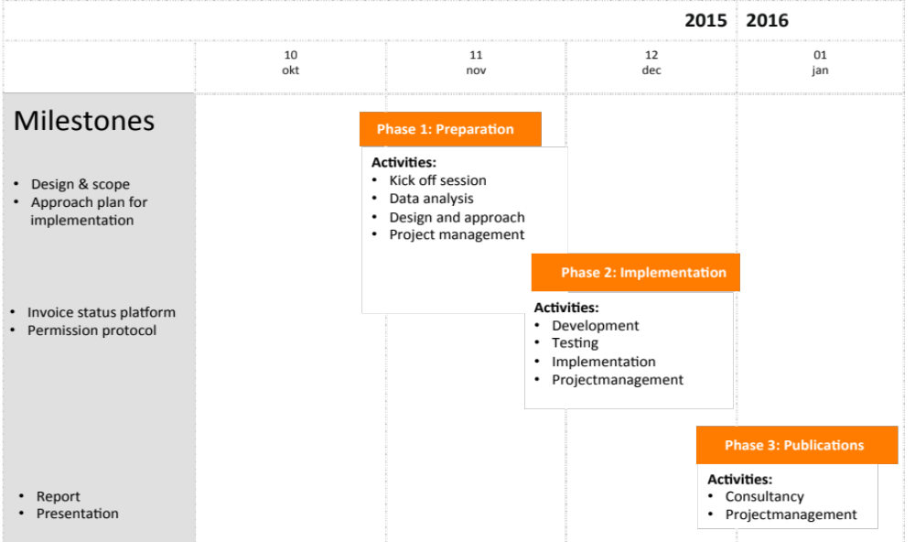
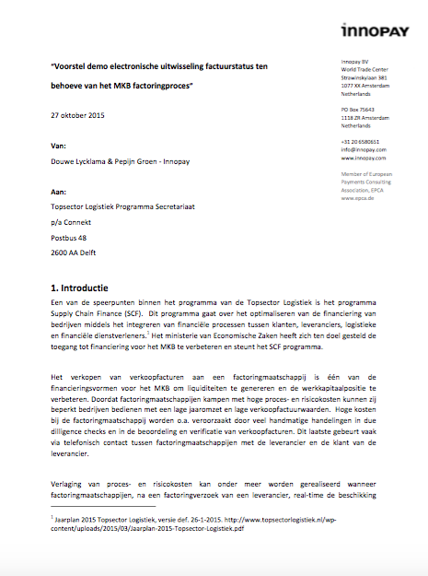
Connekt and Innopay agreed upon a three-phased approach to demonstrate the concept of invoice status exchange

Slide 10
Agenda
1
Introduction round
2
Project history and update
3
Benefits of exchanging invoice status
4
Demonstration of the concept
5
Overview lessons learned and next steps

Slide 11
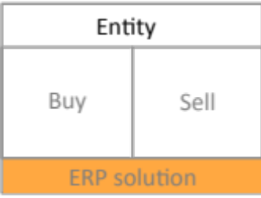




The problem: Unpredictability leads to challenges for selling parties in managing their cash positions
Invoice sent
Invoice sent
Financier
Cash
Cash
Unpredictable when/if cash will come!
Unpredictable when/if cash will come!
Financier
Financier
Financier
Entity
Buy
Sell
Cash flow forecasting can’t be optimized due to limited visibility on invoice status and payments
ERP solution
Restrictions on working capital reserves to deal with trading risks (e.g. non-payment, disputes, performance)
The asymmetry between the flow of cash and the flow of invoice information (e.g. payment terms) between Seller and Buyer lead to uncertain financing possibilities
Limited access to financiers receivables financing offerings (e.g. reverse factoring, asset-based financing) due to high process and financing cost as well as dependency from cooperation from buyers

Slide 12
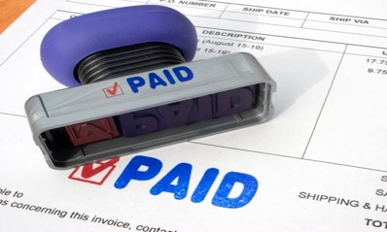


We can learn process transparency from other industries
Usage of status information in an E-Commerce context:
1
Status of shipment:
Accepted for shipment
Driver on his way
Delivery
Possible usage of status information in the invoicing and financing context:
2
Status of invoice:
Received invoice
Approved invoice
Guaranteed invoice

Slide 13
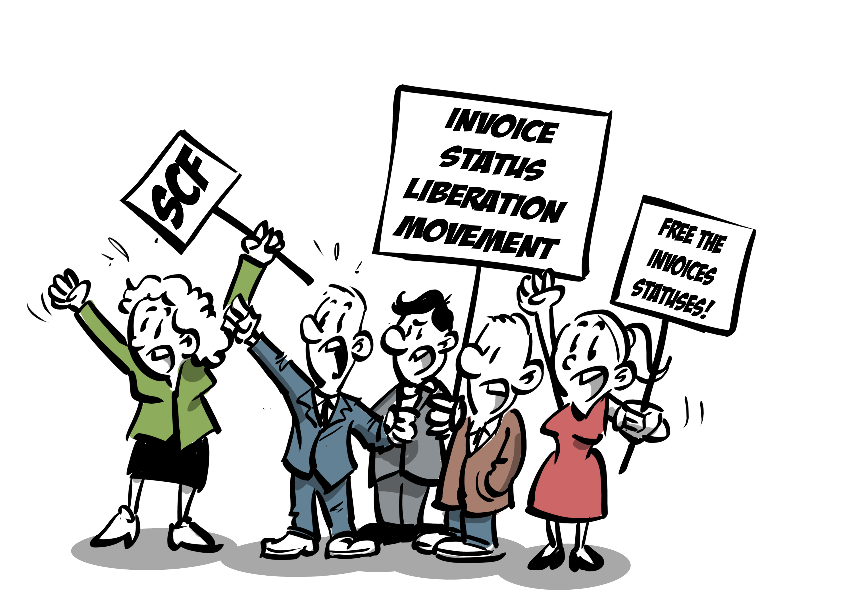
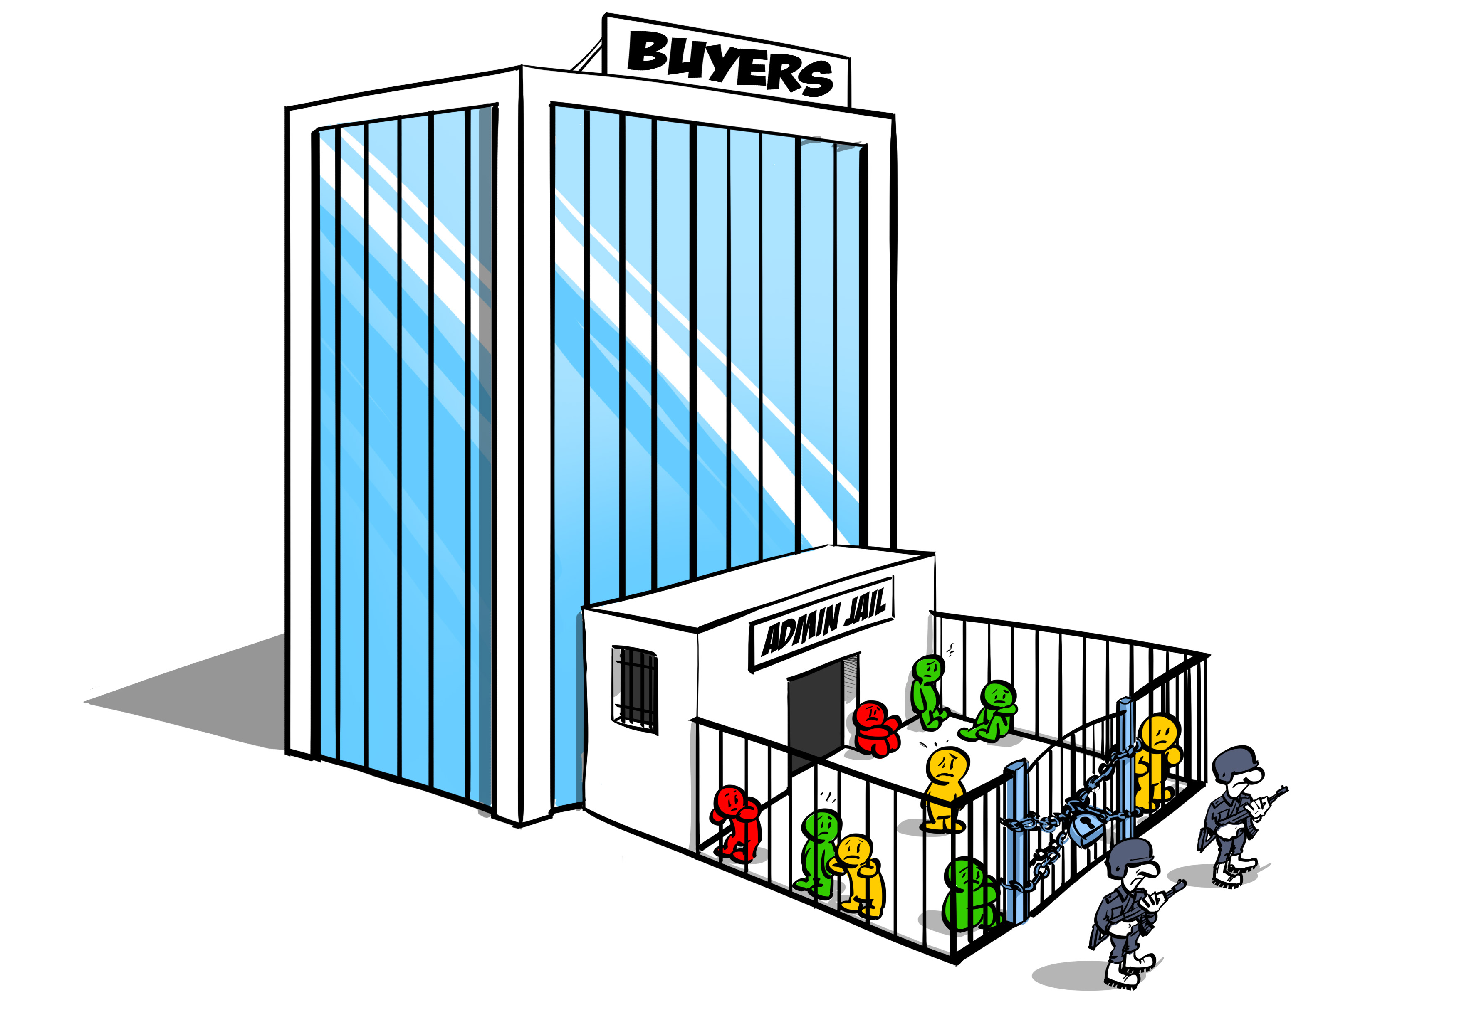
Why lock ‘m up if unleashing invoice statuses helps SME suppliers to find financing? We have to free the invoice statuses!

Slide 14



Hypothesis: The cash position of selling parties is positively influenced when buying parties share invoice statuses with selling parties
1. Example supply chain where invoice statuses are shared:
Invoice sent
Invoice sent
Entity
Share status
Share status
Buyer
Seller
Financier
Financier
Financier
ERP solution
2. Sharing the invoice status leads to:
3. Example invoice statuses:
SEPA PROCESSED
Entity
More transparency for Sellers
More certainty on invoice payments for Financiers and Sellers
Improvement of core processes of Financiers in terms for operational handlings and risks
VERIFIED
Buyer
Seller
LEVEL OF CERTAINTY
APPROVED
REJECTED
ERP solution
PENDING
VIEWED
RECEIVED
STATUS MATURITY

Slide 15
All actors in the supply chain could benefit from the sharing of invoice statuses (financier, selling party & buying party)
Example supply chain where invoice statuses are shared:
Entity
Entity
Entity
Invoice sent
Invoice sent
Buy
Sell
Buy
Sell
Buy
Sell
Entity
Share status
Share status
ERP solution
ERP solution
ERP solution
Buyer
Seller
Financier
Financier
Financier
Financier
ERP solution
Key ‘Financier’ benefits
Lower risks
Process efficiency
Ability to address lower ticket mass market
Key ’Seller’ benefits:
Better cash flow forecasting
Less operational debtor handling
Better access to financing instruments: faster, more choice, easier
Key ‘Buyer’ benefits:
Less operation creditor handling
Strengthening of entity’s supply chain
Optimise internal procurement and invoice approval processes
Invoice discount opportunities
Longer payment term potential

Slide 16
Invoice status sharing is compatible with existing e-business and SCF ecosystems: at least 6 set-ups foreseen
Buying entity gives permission on Selling entity’s request
6 different set-ups for exchange of statuses
Buyer’s ERP communicates directly to Seller’s ERP
Buyer’s (and/or Seller’s) E-invoicing provider(s) communicate to Seller’s Financier
Buyer’s ERP is accessible for Data providers who use statuses to enrich datasets
Buyer’s ERP communicates with Reverse factoring platform, which communicates to Seller’s Financier
Buyer’s ERP communicates with Seller’s financiers through status platform.
Buyer’s ERP communicates directly with Seller’s Financier
Note: In all set-ups the buying party needs to provide permission to the selling party before statuses can be shared!
Goods, Invoice
Goods, Invoice
Share status
Share status
1
Buyer permission needed in all scenarios
Seller sets up process between his buyer and his financier
Financier triggers invoice permission request towards buyer
Buyer gives permission for e.g. one invoice, group of invoices, certain period
Financier
Financier
Financier
E-invoicing provider
E-invoicing provider
2
3
Data providers
4
Tech./RF platform
5
Status platform*
Permission protocol
6
Invoice status exchange
* Used for Proof of Concept

Slide 17
Agenda
1
Introduction round
2
Project history and update
3
Benefits of exchanging invoice status
4
Demonstration of the concept
5
Overview of lessons learned and next steps

Slide 18




Set-up demonstration of concepts
Buying entity gives permission on Selling entity’s request
Innopay
Plays the role of Buyer (only for demo purposes)
Status platform has API access to Innopays =ExactOnline software, which is a cloud solution and popular in the Netherlands amongst SMEs
Homecareinnovation.nl
Client of voldaan factoring B.V. in the role of Seller.
Goods, Invoice
Share status
voldaan factoring B.V.
A non-banking factoring company in the role of Financier that is directly connected to status platform to receive the invoice status.
Financier
Financier
E-invoicing provider
E-invoicing provider
Status platform
Facilitates access via permission protocol for voldaan factoring B.V. to Innopay ‘s ERP solution (i.e. ExactOnline software)
Faciltates automatic and direct exchange of invoice statuses between Innopay and voldaan factoring B.V.
Harmonises invoice status from Exact into one standard format to voldaan factoring B.V.
voldaan factoring B.V.
Data providers
Tech./RF platform
5
Status platform
Permission protocol
Invoicepermissions.com
Invoice status exchange
Notes:
F

Slide 19
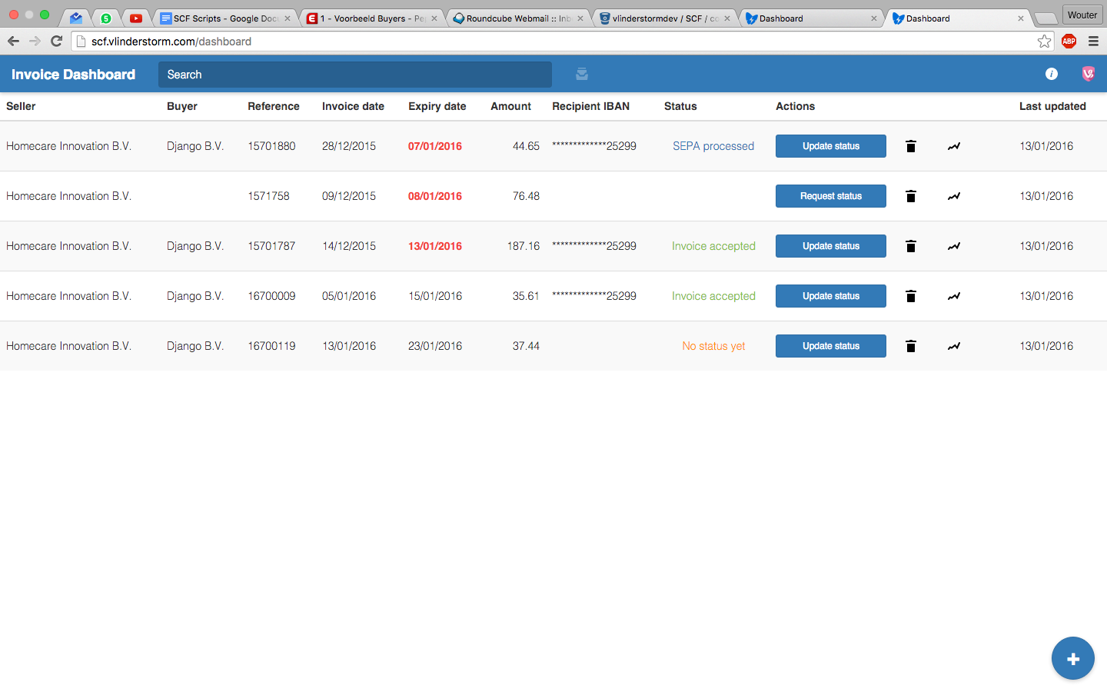
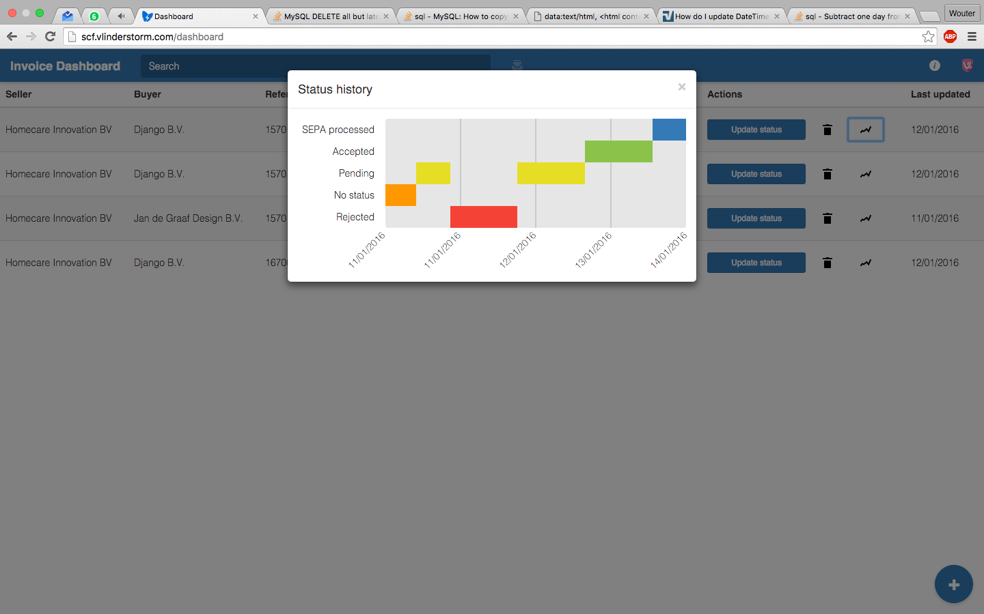
Voldaan can manage the invoice status on its own dashboard
Explanation of most important functionalities
1
2
3
4
History
Voldaan sends permission request to access Innopay’s administration or update invoice status by use of the blue button
4. Status history per invoice is registered to keep track on Innopay’s approval behavior
1. There is one unique invoice reference number that is used by homecareinnovation.nl, Innopay and voldaan factoring B.V.
2. Status of invoice is depicted here. Status keeps being updated when Innopay changes status in own Exact solution
Notes:
New USI wordt getoond in demo

Slide 20
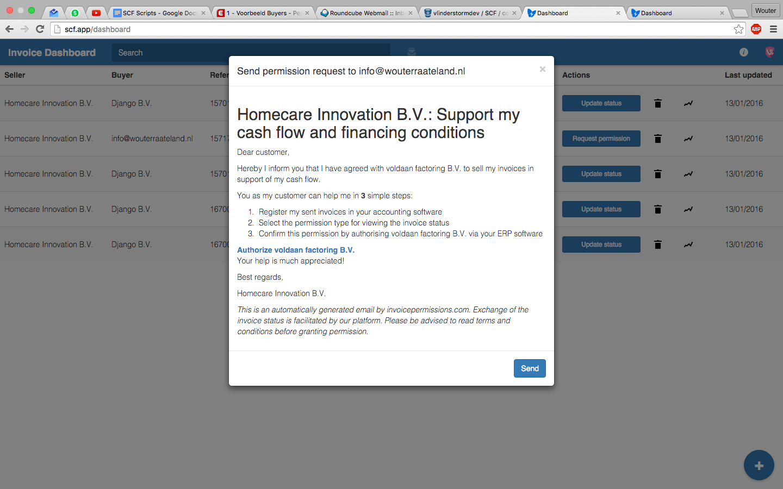
Permission request by Voldaan - on behalf of Homecare innovation – to access Innopay’s administration
pepijn.groen@innopay.com

Slide 21
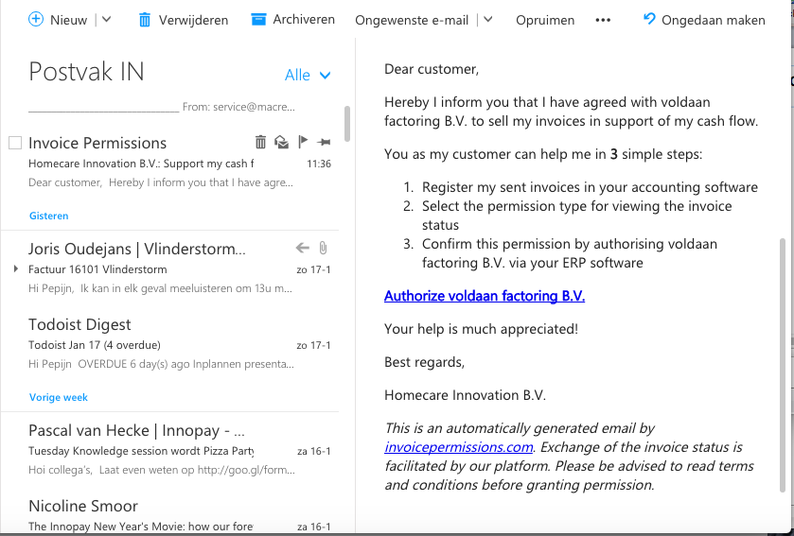
Innopay receives e-mail from Invoicepermissions.com
Innopay receives mail from invoicepermissions.com to support cash flow Homecare Innovation B.V.
Innopay can authorize voldaan factoring B.V. access to the invoice status from its Exact solution by clicking on this link
1
2

Slide 22
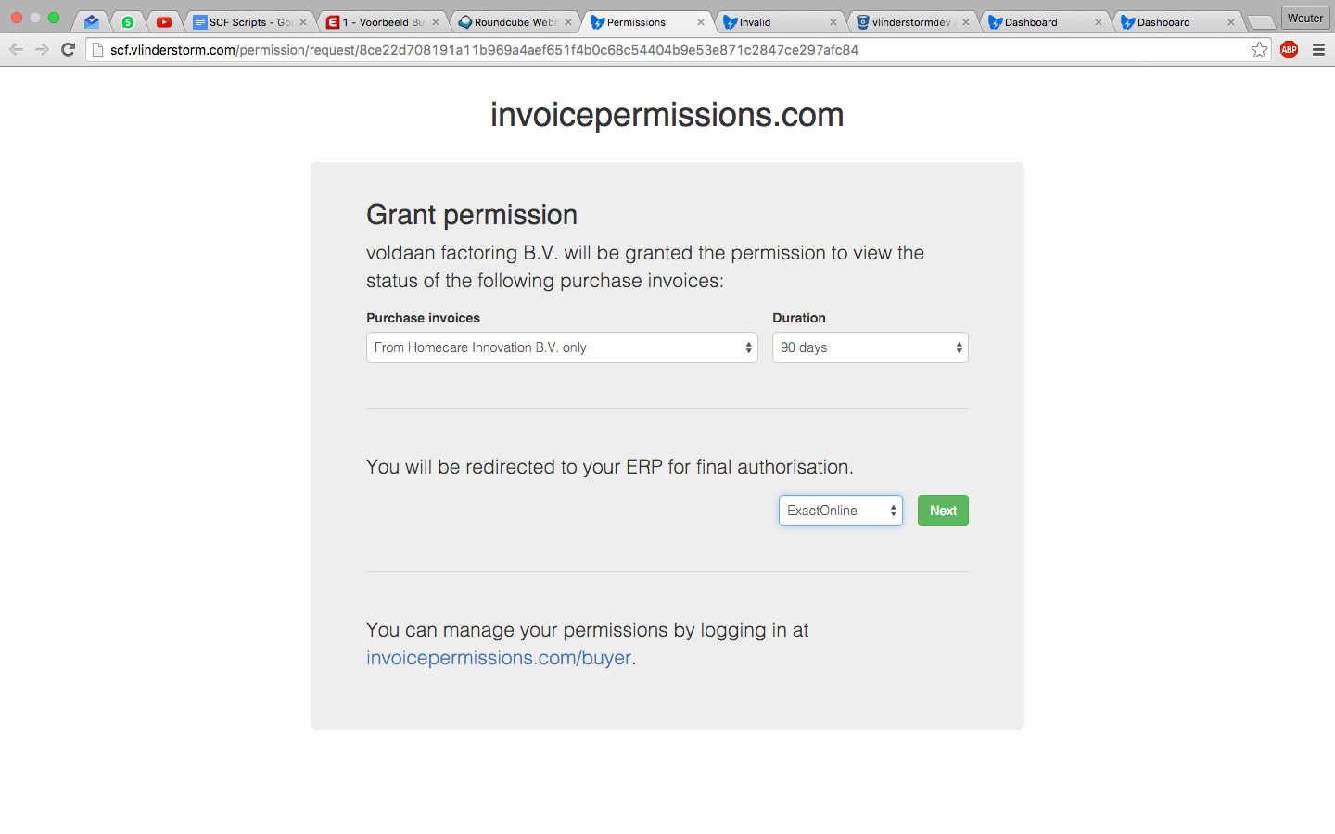
Innopay is redirected from link [ ] to invoicepermissions.com
1. Innopay grants voldaan factoring B.V. permission to receive invoice status for a specific amount of time and/or (fixed) set of invoices of homecare innovation B.V.
1
2. Innopay will be redirected to own ExactOnline for final authorisation
2
3. Permission can be changed by Innopay at any time.
3

Slide 23
Agenda
1
Introduction round
2
Project history and update
3
Benefits of exchanging invoice status
4
Demonstration of the concept
5
Overview of lessons learned and next steps

Slide 24





First lessons learned: demo of concept shows promising potential, but there are several challenges for the next iteration towards standardisation
Non-exhaustive
Which legal aspects have to be addressed for exchanging invoice statuses and using the permission protocol?
How can the exchange of invoice statuses and the permission protocol be operationalised?
What rights and/or liabilities can be attributed to the status of an invoice and the parts thereof?
What legal requirements apply to the permission protocol through which the buyer gives his permission to use the invoice status?
If an independent platform is used for exchanging invoice statuses: what documentation needs to be drawn up for accepting new participants?
……
How to prevent that a seller uses the same invoice twice for financing purposes?
How will the new to be developed standards be maintained and brought to the attention of market participants?
If an independent platform is used for exchanging invoice statuses: who will be responsible for the governance and exploitation of the platform? Will it require a trusted third party who is responsible for the acceptance of new particpants?
…….
Legal
Operational
What functionality and services should be provided for exchanging invoice statuses?
How should the information be exchanged between the involved parties and what technology should be used to do so?
How can the exchange of invoice status be integrated into the administrative processes of the involved parties?
How can the exchange of invoice status be integrated into the risk management processes of the financier?
What other functionality can or needs to be attributed to the permission protocol in order to raise trust with the buyer and the financier?
…….
What architectural principles should apply to the to be developed standards?
How can maximum take-up by buyers, suppliers and financiers can be realised?
How to cope with the large variety of ERP-systems that different buyers use?
…..
Functional
Technical

Slide 25
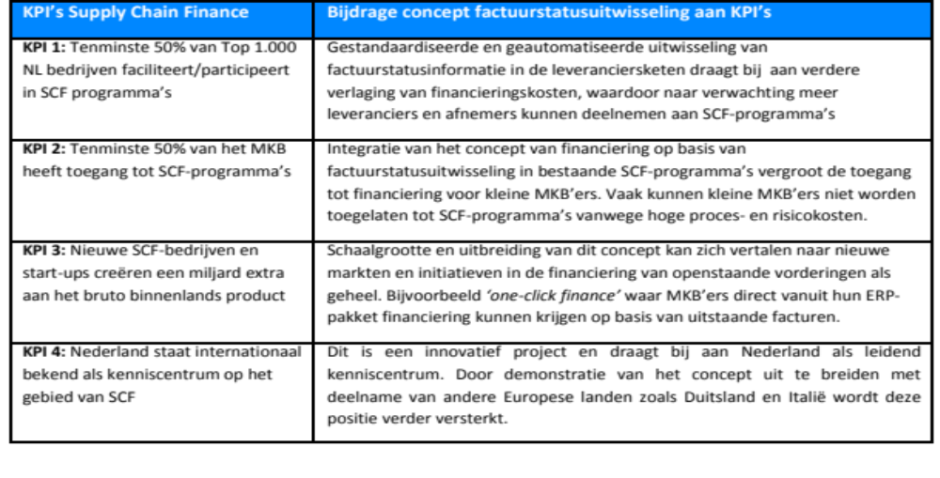
Contribution of project to KPI’s of Supply Chain Finance (SCF) Community
Updated since presentation 29th of January

Slide 26
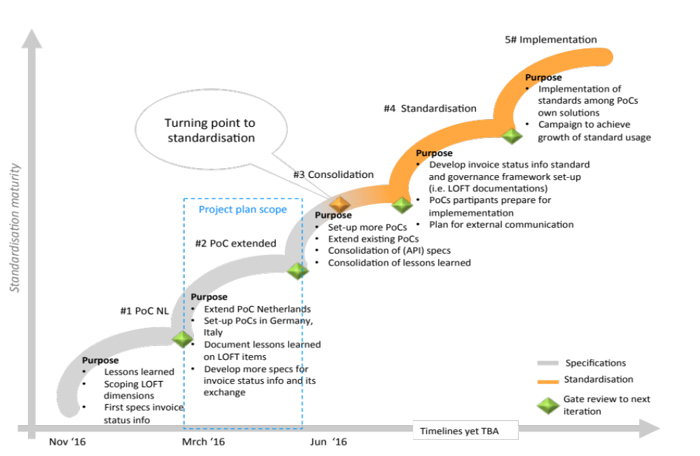
Further demonstrations of the concept form the basis for standardisation and valorisation
26

Slide 27
Project overview
Iteration #1
Today
Iteration #2
Further iterations >>
Project plan
Workshop
17 Nov
Webinar
10 Dec
Workshop
15 Jan
Harmonization of specs
Harmonization of specs
Track 1:
Standardisation
Project plan
Harmonization of specs
Knowledge sharing
PoC reports
PoC report
New PoC A
New PoC B
Working PoCs
Track 2:
Proof of Concept
PoC presentation
Specification & design PoC
Working PoC platform
PoC presentations
PoC live
New PoC C
PoC NL Sprint 1
PoC NL Sprint 2
PoC NL Sprint 3
Extend NL PoC
Track 3:
Project-mgmt
Iteration review
Iteration review
Meetings & regular touch points
Nov 2`015
Dec 2015
Jan 2016
Mar – Apr – May 2016
Onwards >>

Slide 28



Contact us
Douwe Lycklama
douwe@innopay.com
+31 6 55 71 11 50
Friso Spinhoven
Friso.spinhoven@innopay.com
+31 6 83 22 38 79
Pepijn Groen
pepijn.groen@innopay.com
+31 6 24 89 72 99
We look forward to it

Slide 29
  Sharing the invoice status increases risk transparency for Financiers
Data enrichment (e.g. transaction history, solvability ratio)
 |  | Invoice status information classification
 |  | Received | Viewed | Pending | Approved | Verified | Processed | Rejected
 |  | Informed that the invoice is registered in Buyer’s administration | Informed that invoice has been seen by the Buyer | Informed by Buyer that invoice is being discussed (e.g. internal check, dispute, terms negotiation) | Informed by Buyer that invoice is correct | Informed by authorised representative of Buyer that invoice is correct | Received payment guarantee by authorised representative | Informed by Buyer that invoice is not approved
Risk component | Fraud | - | - | - | √ | √ | √ | √
 | Dispute | - | - | - | √ | √ | √ | √
 | Counterparty | - | - | - | - | √ | √ | √
 | Performance | - | - | - | - | - | √ | √
Part of Standardisation process

